Slide 1
HATE CRIME DATA ANALYSIS
By: Sara Rostami

Slide 2
TABLE OF CONTENTS
Introduction
Preprocess
Questions
DDA
What is hate crime & introducing our dataset
Cleaning the data and adding the needed columns
Defining the questions about our dataset
Answering the questions about the data with Descriptive data analysis

Slide 3
INTRODUCTION
Hate crime is any criminal offence perceived by the victim, or anybody else, to be motivated by hostility or prejudice towards someone’s:
race, religion, sexual orientation, transgender identity, and disability
1/19

Slide 4
INTRODUCTION )Cont.)
Dataset
incident_id
incident_date
28 columns
data_year
226328 Rows
state_name
state_abbr
12 Selected columns
bias_desc
offense_name
victim_types
offender_race
offender_ethnicity
multiple_offense
multiple_bias
2/19

Slide 5
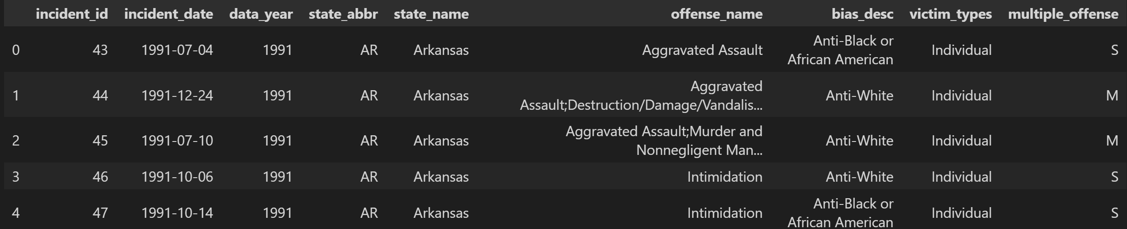
INTRODUCTION )Cont.)
3/19

Slide 6
PREPROCESS
Investigating the number of missing values and unique values
Filling missing/NaN values
Converting some column types to “categorical”
Converting incident_date column to “datetime”
Removing Rows that are not US states (just territories)
Adding the needed columns:
total_hate_crimes_per_year
total_hate_crimes_per_state_per_year
4/19

Slide 7
Questions
What category of biases are the most significant contributors to hate crimes?
What are the most frequent types victims of hate crimes?
How is the hate crime trend changed over the years?
What states are the most significant contributors to hate crimes?
What category of hate crimes are the most recurring ones?
5/19

Slide 8
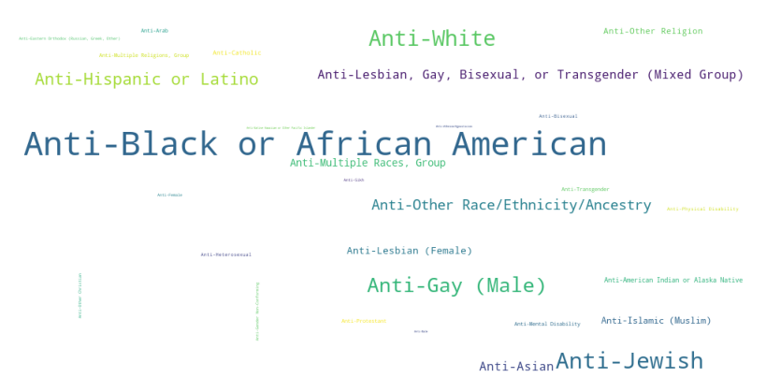
DDA – Q1
6/19

Slide 9
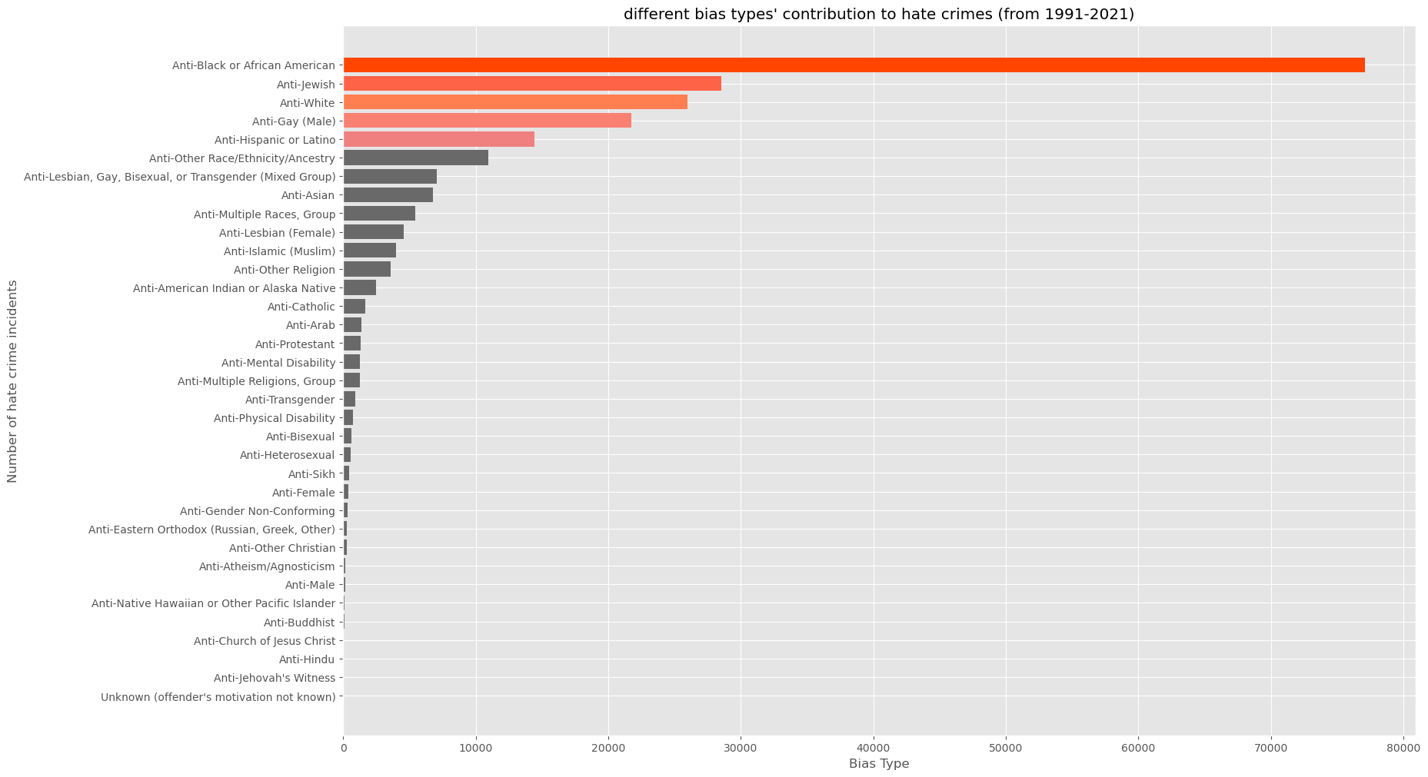
DDA – Q1
7/19

Slide 10
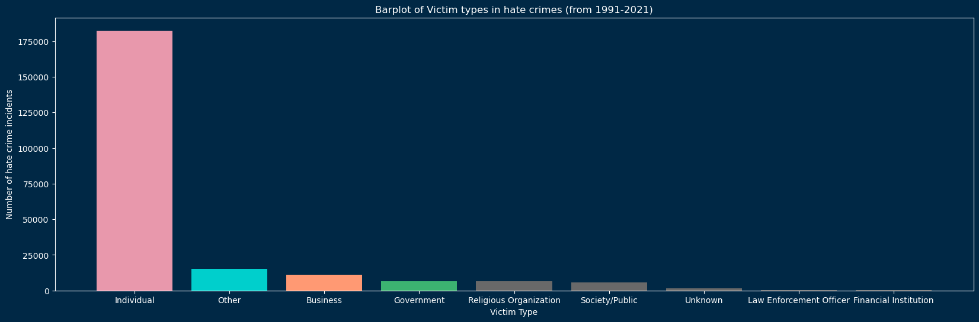
DDA – Q2
8/19

Slide 11
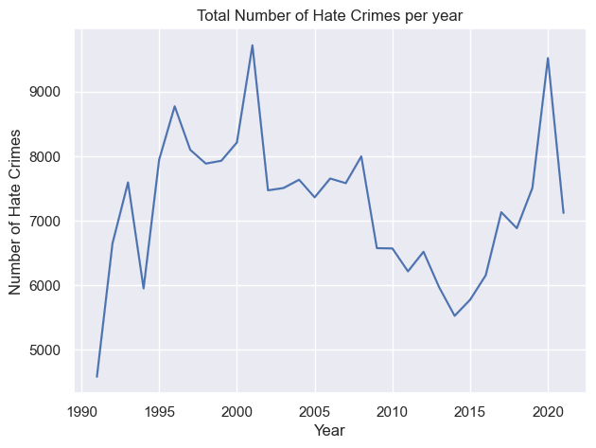
DDA – Q3
1996
2001
2020
2008
1993
1991
9/19

Slide 12
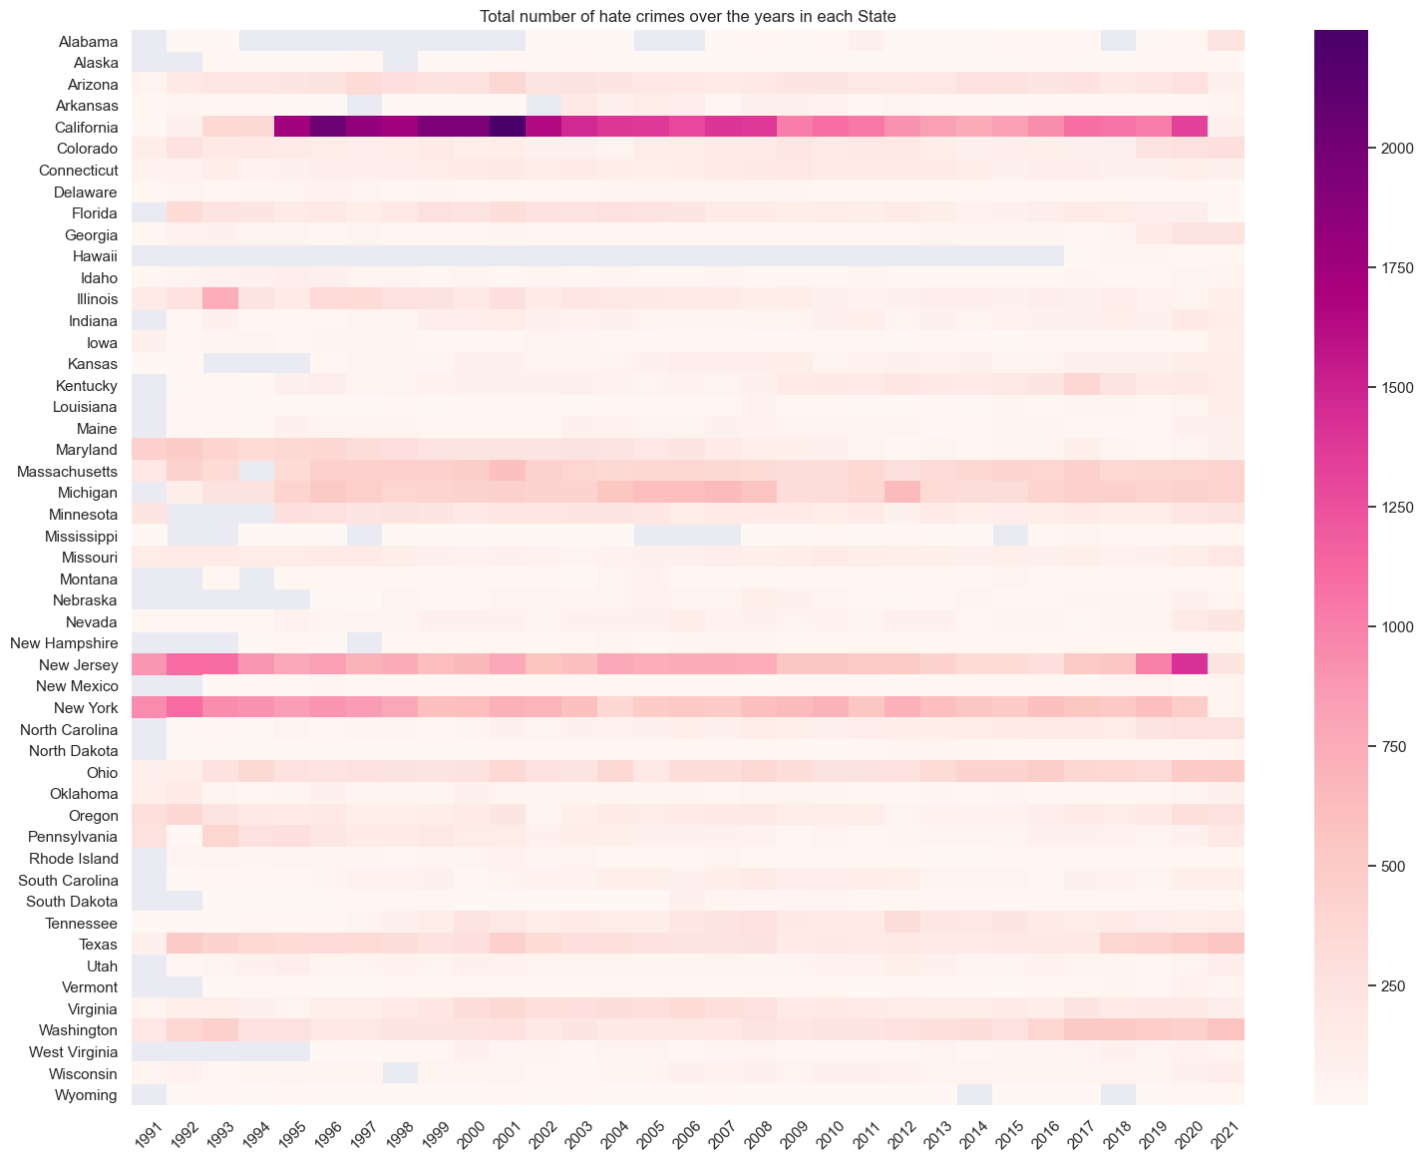
DDA – Q4
10/19

Slide 13
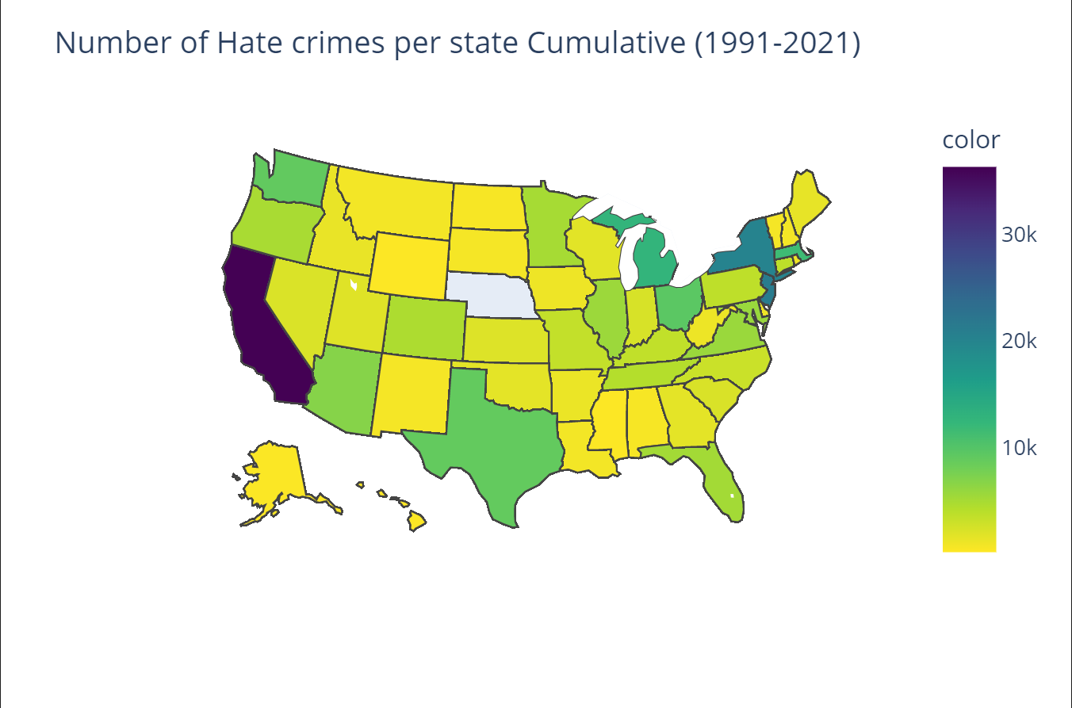
DDA – Q4
New York
California
New Jersey
11/19

Slide 14
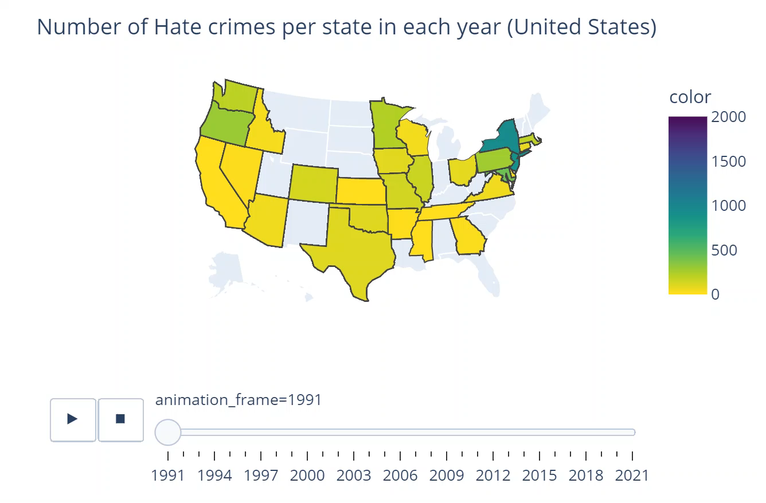
DDA – Q4
12/19

Slide 15
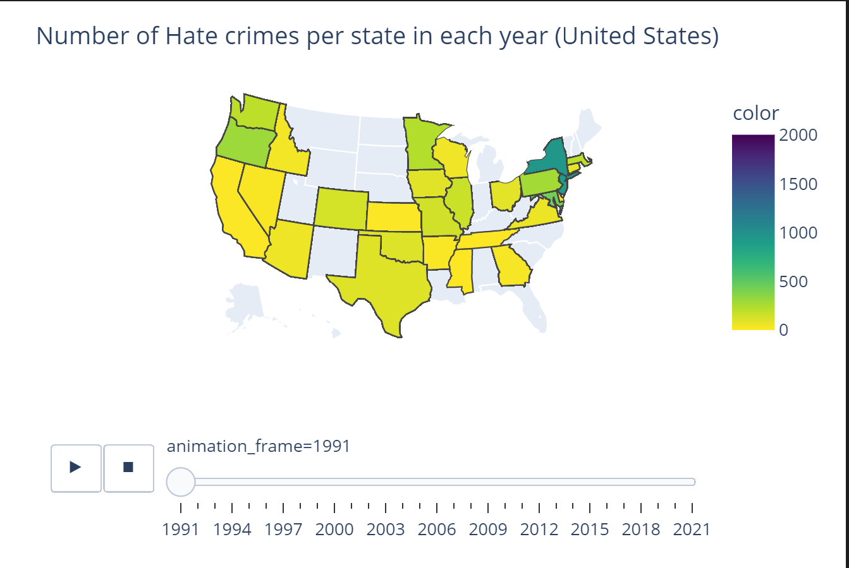
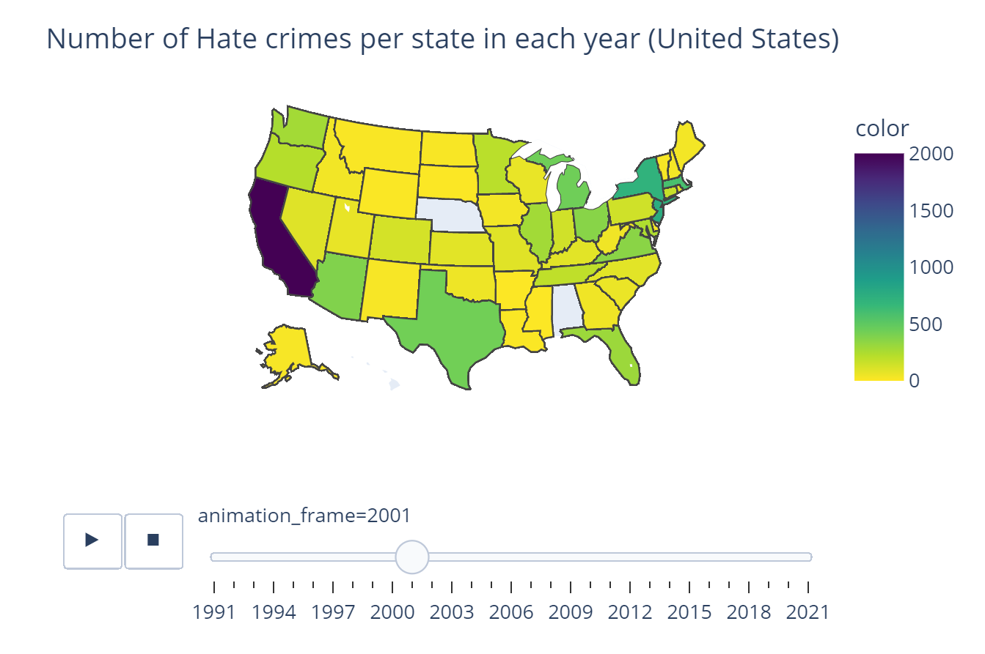
DDA – Q4
Minimum Year
Maximum Year
13/19

Slide 16
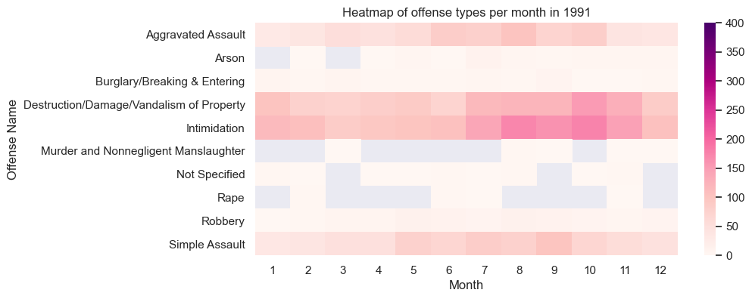
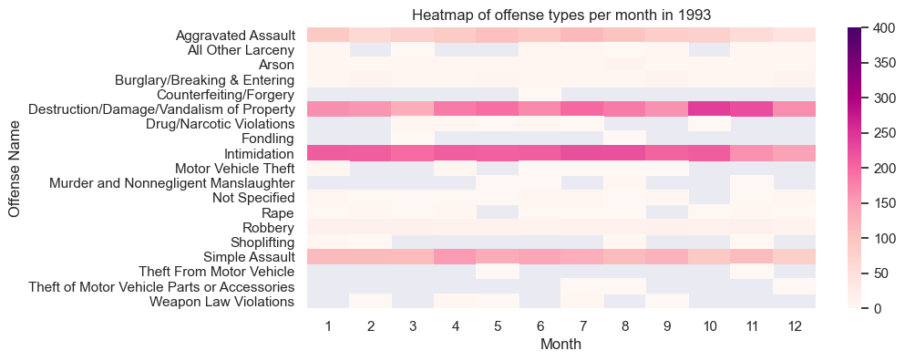
DDA – Q5
14/19

Slide 17
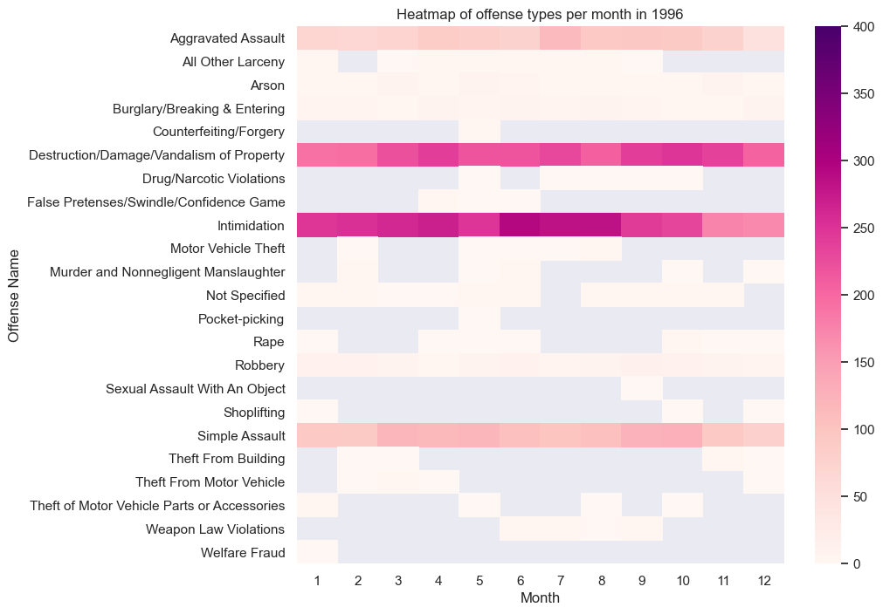
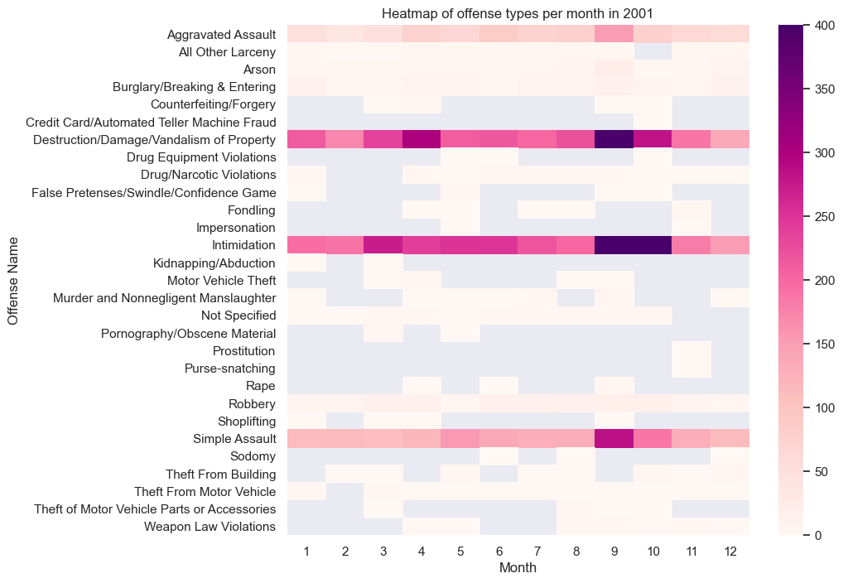
DDA – Q5
15/19

Slide 18
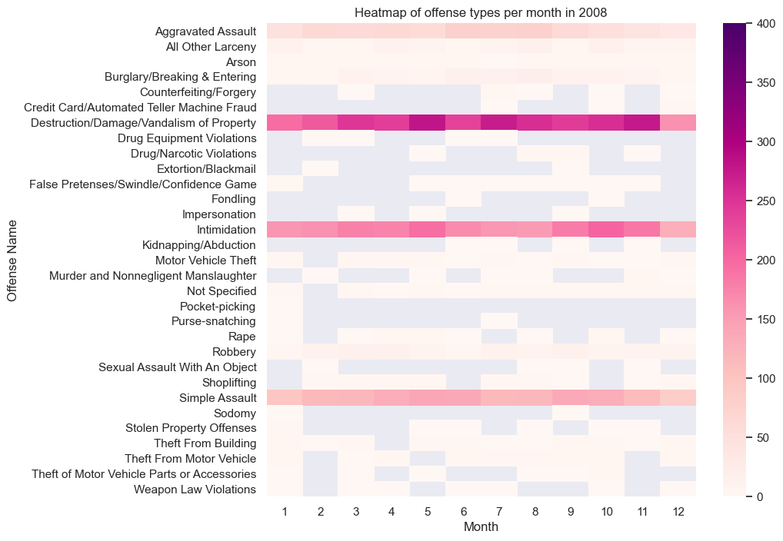
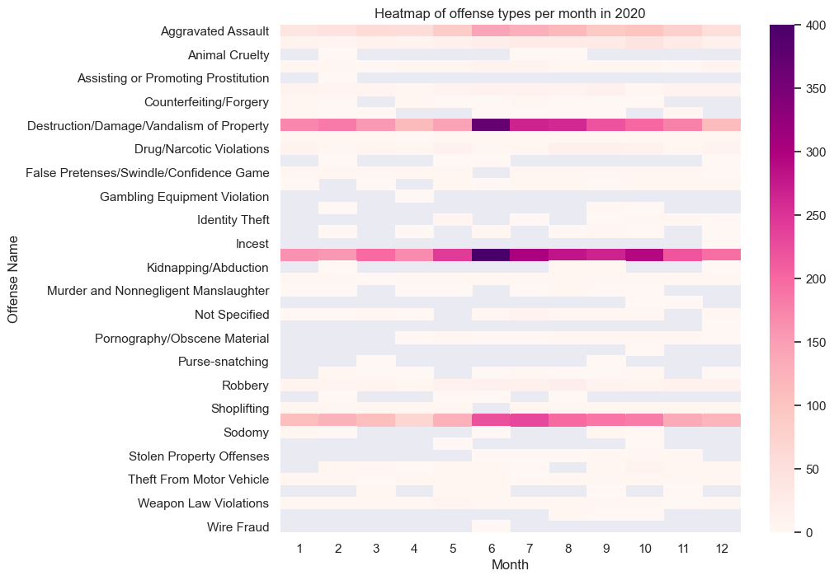
DDA – Q5
16/19

Slide 19
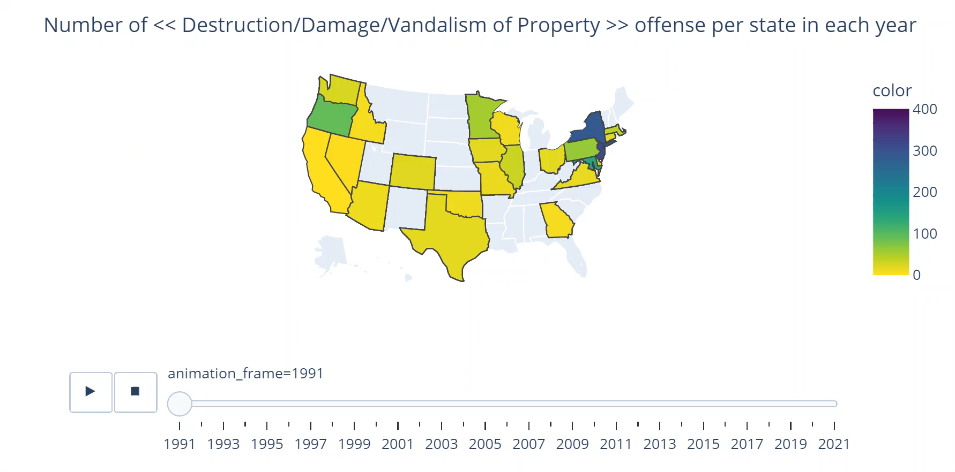
DDA – Q5 (Most frequent Offense)
17/19

Slide 20
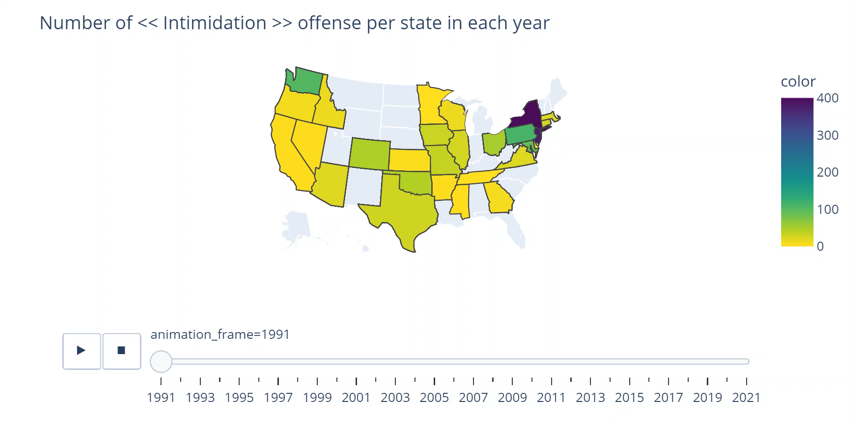
DDA – Q5 (2nd Most frequent Offense)
18/19

Slide 21
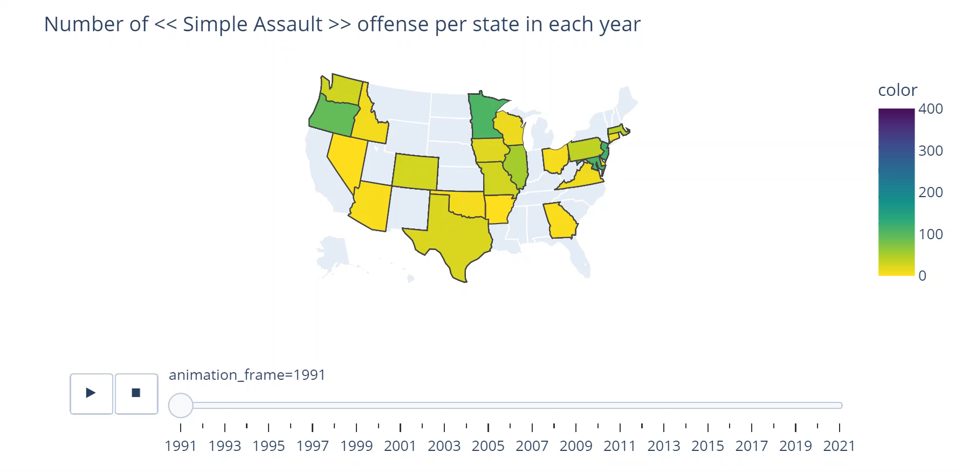
DDA – Q5 (3rd Most frequent Offense)
19/19

Slide 22
THANK YOU!

